Slide 1
Deep Learning
Basic Philosophy
Why Deep Learning
Deep Backpropagation
CNN – Convolutional Neural Networks
Unsupervised Preprocessing Networks
Stacked Auto Encoders
Deep Belief Networks
Deep Supervised Networks with managed gradient approaches
Deep Reinforcement Learning
Notes:
Pre-Traiining

Slide 2
Deep Learning Overview
Train networks with many layers (vs. shallow nets with just a couple of layers)
Multiple layers work to build an improved feature space
First layer learns 1st order features (e.g. edges…)
2nd layer learns higher order features (combinations of first layer features, combinations of edges, etc.)
Some models learn in an unsupervised mode and discover general features of the input space – serving multiple tasks related to the unsupervised instances (image recognition, etc.)
Final layer of transformed features are fed into supervised layer(s)
And entire network is often subsequently tuned using supervised training of the entire net, using the initial weightings learned in the unsupervised phase

Slide 3
Deep Net Feature Transformation
Supervised
Learning
ML Model
New Feature Space
Supervised
or
unsupervised
Learning
Original Features
Notes:
Can input both new and original spaces
Unsupervised pre-training

Slide 4
Deep Learning Tasks
For some approaches (CNN, Unsupervised) best when input space is locally structured – spatial or temporal: images, language, etc. vs arbitrary input features
Images Example: view of a learned vision feature layer (Basis)
Each square in the figure shows the input image that maximally activates one of the 100 units
Notes:
Each square in the figure above shows the (norm bounded) input image that maximally activates one of 100 hidden units. We see that the different hidden units have learned to detect edges at different positions and orientations in the image.
This image if for a simple auto-encoder with 100 hidden units trained on 10x10 images (from UFLDL tutorial)

Slide 5
Why Deep Learning
Biological Plausibility – e.g. Visual Cortex
Hastad proof - Problems which can be represented with a polynomial number of nodes with k layers, may require an exponential number of nodes with k-1 layers (e.g. parity)
Highly varying functions can be efficiently represented with deep architectures
Less weights/parameters to update than a less efficient shallow representation
Sub-features created in deep architecture can potentially be shared between multiple tasks
Type of Transfer/Multi-task learning

Slide 6
Neural Networks Sketch
More than just MLPs, but…
Rumelhart 1986 – great early success
Interest subsides a bit in the late 90’s as other models are introduced – SVMs, Graphical models, etc. – each their turn...
Convolutional Neural Nets –LeCun 1989-> Image, speech, etc.
Deep Belief nets (Hinton) and Stacked auto-encoders (Bengio) – 2006 – Unsupervised pre-training followed by supervised. Good feature extractors.
2012 -> Initial successes with supervised approaches which overcome vanishing gradient, etc., and are more general applicable. Current explosion, but don’t drop all the other tools in your kit!
Stay the course

Slide 7
Early Work
Fukushima (1980) – Neo-Cognitron
LeCun (1998) – Convolutional Neural Networks (CNN)
Similarities to Neo-Cognitron
Many layered MLP with backpropagation
Tried early but without much success
Very slow
Vanishing gradient
Relatively recent work demonstrated significant accuracy improvements by "patiently" training deeper MLPs with BP using fast machines (GPUs)
More general learning!
Much improved since 2012 with lots of extensions to the basic BP algorithm

Slide 8
Vanishing/Exploding Gradient
Error attenuation, long patient training with GPUs, etc
Recent algorithmic improvements - Rectified Linear Units,
better weight initialization, normalization between layers, residual
deep learning, etc. – 1000’s of layers being effectively trained
….
Notes:
Usually more nodes in internal layers than input layer, layers not same size
Save this until later slide which has it.: Another important reason error is low. Final layer updates weights so that overall accuracy is pretty good just based on the last hidden layer (and the still pretty much initial weights of the earlier layers). Thus T-Z already gets small pretty fast based on just the learning of the last few layers using the initial layers as a random shuffle.
RLEs, constant derivate, thus just can treat as 1 and scale with LR. 0 once saturated, can come back? Review these more before next time
Evidence that tanh and other activations better than sigmoid for avoiding early top layer saturation

Slide 9
Unstable Gradient
Early layers of MLP do not get trained well
Vanishing Gradient – error attenuates as it propagates to earlier layers – t - z < 1, f '(net), scaled by small initial weights
Leads to very slow training (especially at early layers)
Exacerbated since top couple layers can usually learn any task "pretty well" and thus the error to earlier layers drops quickly as the top layers "mostly" solve the task– lower layers never get the opportunity to use their capacity to improve results, they just do a random feature map
Need a way for early layers to do effective work
Instability of gradient in deep networks: Vanishing or exploding gradient
Product of many terms, which unless “balanced” just right, is unstable
Either early or late layers stuck while “opposite” layers are learning
Notes:
If weights were large gradient could explode as go down the net –much less common but still can happen
Note large weights usually lead to saturation and even smaller f’(net)
: Another important reason error is low. Final layer updates weights so that overall accuracy is pretty good just based on the last hidden layer (and the still pretty much initial weights of the earlier layers). Thus T-Z already gets small pretty fast based on just the learning of the last few layers using the initial layers as a random shuffle.
Local minima? Some say, More likely difficult slow curvatures (Martens: Hessian Free Learning), Properly tuned Moment with proper initial conditions can make a big difference.
LSTM are more specialized approach for very long memory cases, but is it best for typical tasks? Hessian free claims to out-perform it and can also do the specialized tasks

Slide 10
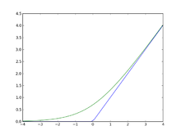
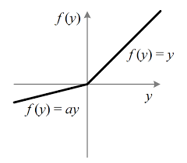
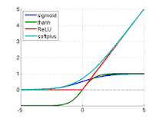
Rectified Linear Units
f(x) = Max(0,x) More efficient gradient propagation, derivative is 0 or constant, just fold into learning rate
Helps f '(net) issue, but still left with other unstable gradient issues
More efficient computation: Only comparison, addition and multiplication.
Leaky ReLU f(x) = x if x > 0 else ax, where 0 ≤ a <= 1, so that derivate is not 0 and can do some learning for net < 0 (does not “die”).
Lots of other variations
Sparse activation: For example, in a randomly initialized networks, only about 50% of hidden units are activated (having a non-zero output)
Learning in linear range easier for most learning models
Notes:
Green is softplus function f(x) = ls(1+e^x) (smooth version of RLU), whose derivative is the sigmoid 1/(1+e^-x)
For regular ReLU, set bias slightly positive, so that active to start with
Leaky ReLU f(x) = x if > 0 else .01x – some effect for x < 0
Note ReLU is not everywhere differentiable. At 0 just choose left or right derivative (0 or 1) and works fine empirically, though theoretically a bit bothersome – Note that since net is real number the prob(0) = 0 anyways and if computer has 0, probably just a representation issue and we would be a little to the left or right anyways in a true system.
So why not same with threshold function? Derivate would be 0 everywhere with no learning
Principle: Nets easier to optimize when there behavior is closer to linear
Still learning why ReLUs work as well as they do

Slide 11
Softmax and Cross-Entropy
Sum-squared error (L2) loss gradient seeks the maximum likelihood hypothesis under the assumption that the training data can be modeled by Normally distributed noise added to the target function value. Fine for regression but less natural for classification.
For classification problems it is advantageous and increasingly popular to use the softmax activation function, just at the output layer, with the cross-entropy loss function. Softmax (softens) 1 of n targets to mimic a probability vector for each output.
Cross entropy seeks to to find the maximum likelihood hypotheses under the assumption that the observed (1 of n) Boolean outputs is a probabilistic function of the input instance. Maximizing likelihood is cast as the equivalent minimizing of the negative log likelihood.
With new loss and activation functions, we must recalculate the gradient equation. Gradient/Error on the output is just (t-z), no f '(net)! The exponent of softmax is unraveled by the ln of cross entropy. Helps avoid gradient saturation.
Common with deep networks, with ReLU activations for the hidden nodes
Notes:
Cross entropy with sigmoid also has t-z gradient as ln undoes exponential of sigmoid.
Softmax with TSS gives gradient of (t-z)z(d-z of target node) where d is of 1 if node is target, else 0, saturates and global
CE loss – 0 for non target nodes, and ln(z) for target node. Thus if z = 1 0, loss, loss grows as z approaches 0

Slide 12
Convolutional Neural Networks
Niche networks built specifically for problems with low dimensional (e.g. 2-d) grid-like local structure
Character recognition – where neighboring pixels will have high correlations and local features (edges, corners, etc.), while distant pixels (features) are un-correlated
Natural images have the property of being stationary, meaning that the statistics of one part of the image are the same as any other part
Some biological plausibility from visual cortex
While standard NN nodes take input from all nodes in the previous layer, CNNs enforce that a node receives only a small set of features which are spatially or temporally close to each other called receptive fields from one layer to the next (e.g. 3x3, 5x5), thus enforcing ability to handle local 2-D structure.
Can find edges, corners, endpoints, etc.
Good for problems with local 2-D structure, but lousy for general learning with abstract features having no prescribed feature ordering or locality
Notes:
Exact position of detected feature not important, but the relative positions can be and can be captured by later layers
5x5, 4x4 common

Slide 13
Convolutions
Typical MLPs have a connection from every node in the previous layer, and the net value for a node is the scalar dot product of the inputs and weights (e.g. matrix multiply). Convolutional nets are somewhat different:
Nodes still do a scalar dot product (convolution) from the previous layer, but with only a small portion (receptive field) of the nodes in the previous layer – Sparse representation
Every node has the exact same weight values from the preceding layer – Shared parameters, tied weights, a LOT less unique weight values. Regularization by having same weights looking at more input situations
Each node has it’s shared weight convolution computed on a receptive field slightly shifted, from that of it’s neighbor, in the previous layer – Translation invariance.
Each node’s convolution scalar is then passed through a non-linear activation function (ReLU, tanh, etc.)

Slide 14

Convolution Example

Slide 15
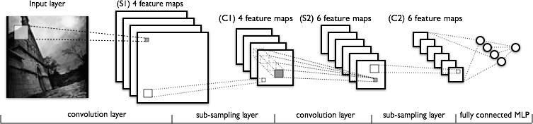
Convolutional Neural Networks
C layers are convolutions, S layers pool/sample
Often starts with fairly raw features at initial input and lets CNN discover improved feature layer for final supervised learner – eg. MLP/BP
Notes:
Each feature map should learn a different feature.
Brute force effort to see if and where certain features exist.
Pooling/sampling – Does the feature exist in a general area
Final standard supervised layer

Slide 16
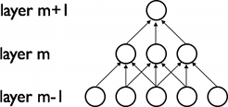
CNN – Translation Invariance
The 2-d planes of nodes (or their outputs) at subsequent layers in a CNN are called feature maps
To deal with translation invariance, each node in a feature map has the same weights (based on the feature it is looking for), and each node connects to a different overlapping receptive field of the previous layer
Thus each feature map searches the full previous layer to see if, where, and how often its feature occurs (precise position less critical)
The output will be high at each node in the map corresponding to a receptive field where the feature occurs
Later layers could concern themselves with higher order combinations of features and rough relative positions
Each calculation of a node’s net value, Σxw+b in the feature map, is called a convolution, based on the similarity to standard convolutions
Notes:
Exact position of detected feature not important, but the relative positions can be and can be captured by later layers
5x5, 4x4 common
Convolution input, kernel (learned convolution of weights - tensor), and feature map output

Slide 17
CNN Structure
Each node (e.g. convolution) is calculated for each receptive field in the previous layer
During training the corresponding weights are always tied to be the same (ala BPTT)
Thus a relatively small number of unique weight parameters to learn, although they are replicated many times in the feature map
Each node output in CNN is f(Σxw + b) (ReLU, tanh etc.)
Multiple feature maps in each layer
Each feature map should learn a different translation invariant feature
Since after first layer, there are always multiple feature maps to connect to the next layer, it is a pre-made human decision as to which previous maps the current convolution map receives inputs from, could connect to all or a subset (S2 in figure below)
Convolution layer causes total number of features to increase
Notes:
Note increase in first convolution layer from initial image
Some models let each node have a unique (rather than shared) bias weight
Total features increase, but not the volume of any given feature map stays same (zero-padded) or decreases (save)

Slide 18
Sub-Sampling (Pooling)
Convolution and sub-sampling layers are interleaved
Sub-sampling (Pooling) allows number of features to be diminished, and to pool information
Pooling replaces the network output at a certain point with a summary statistic of nearby outputs
Max-Pooling common (Just as long as the feature is there, take the max, as exact position is not that critical), also averaging, etc.
Pooling smooths the data and reduces spatial resolution and thus naturally decreases importance of exactly where a feature was found, just keeping the rough location – translation invariance
2x2 pooling would do 4:1 compression, 3x3 9:1, etc.
Convolution usually increases number of feature maps, pooling keeps same number of reduced maps (one-to-one correspondence of convolution map to pooled map) as the previous layer
Notes:
L2 pooling – Square root of sum of the activation squares in the field – ~average magnitude
Max pooling – winner take all for receptive field
Small fields most common (2x2), also allows for deeper network
Note depth of network is basically decided by the sub sampling pool size, since once the feature maps are small (e.g. 5x5) there no more room for convoluting and need to just put then in the MLP
Can get some effects of Pooling and save computation by having convolutional layers less tightly overlapped (stride)

Slide 19
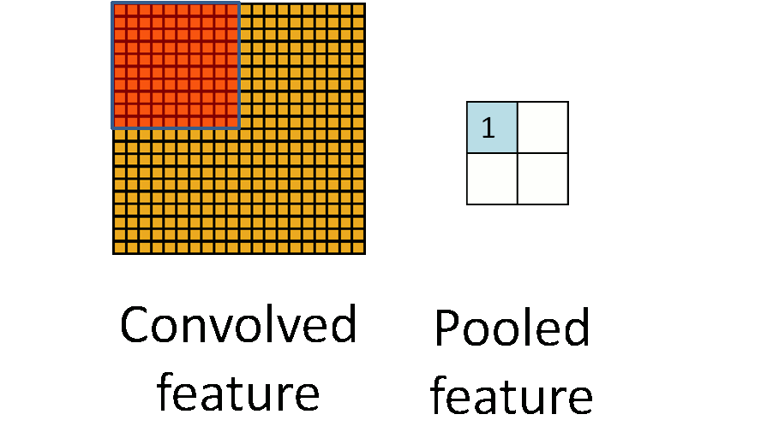
Pooling Example (Summing or averaging)
Notes:
Usually smaller receptive fields, can overlap some

Slide 20
Pooling (cont.)
Common layers are convolution, non-linearity, then pool (repeat)
Note that pooling always decreases map volumes (unless pool stride = 1, highly overlapped), making real deep nets more difficult. Pooling is sometimes used only after multiple convolved layers and sometimes not at all.
At later layers pooling can make network invariant to more than just translation – learned invariances
Notes:
Create “Grandmother” cells corresponding do different variants of the concept

Slide 21
CNN Training
Trained with BP but with weight tying in each feature map
Randomized initial weights through entire network
Just average the weight updates over the tied weights in feature map layers
Convolution layer
Each feature map has one weight for each input and one bias
Thus a feature map with a 5x5 receptive field (filter) would have a total of 26 weights, which are the same coming into each node of the feature map
If a convolution layer had 10 feature maps, then only a total of 260 unique weights to be trained in that layer (much less than an arbitrary deep net layer without sharing)
Sub-Sampling (Pooling) Layer
All elements of receptive field max’d, averaged, summed, etc. Result multiplied by one trainable weight and a bias added, then passed through non-linear function (detector, e.g. ReLU) for each pooling node
If a layer had 10 pooling feature maps, then 20 unique weights to be trained
While all weights are trained, the structure of the CNN is currently usually hand crafted with trial and error.
Number of total layers, number of receptive fields, size of receptive fields, size of sub-sampling (pooling) fields, which fields of the previous layer to connect to
Typically decrease size of feature maps and increase number of feature maps for later layers
Notes:
Note that pooling (size and function) are hand-crafted by the network designer, though there is a trainable weight and bias to “tune” the pooling
Or BP variant
Can use Local response normalization or variants – effort to have feature maps learn different features, but not essential
But standard BP already deals with that since trying to minimize errors and if all hidden nodes learned the same function, then would get lousy accuracy, with easy problem could duplicate, but then that is all right.
Usually need more maps in layers (100s…)

Slide 22
CNN Hyperparameters
Structure itself, number of layers, size of filters, number of feature maps in convolution layers, connectivity between layers, activation functions, final supervised layers, etc.
Drop-out often used in final fully connected layers for overfit avoidance – less critical in convolution/pooling layers which already regularize due to weight sharing
Stride – Don’t have to test every location for the feature (i.e. stride = 1), could sample more coarsely
Another option (besides pooling) for down-sampling
As is, the feature map would always decrease in volume which is not always desirable - Zero-padding avoids this and lets us maintain up to the same volume
Would shrink fast for large kernel/filter sizes and would limit the depth (number of layers) in the network
Also allows the different filter sizes to fit arbitrary map widths
Notes:
Locally unique connections – Same map size but weights trained independently
Tiled convolution – neighbor node uses different kernel, but kernels repeat after some stride
Could have a stride value in each dimension

Slide 23
Convolution Example
Notes:
Show stride = 2, and need to 0 map with this picture

Slide 24
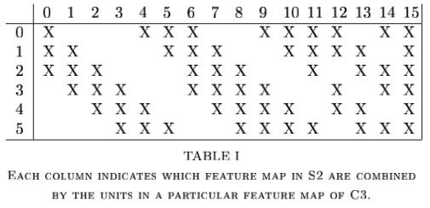
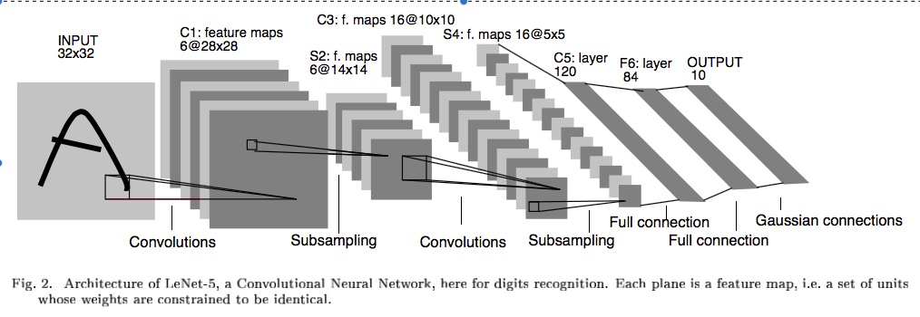
Example – LeNet-5 – MNIST Classification
To help it all sink in:
How many weights to be trained at each layer?
5x5 2x2 5x5 2x2 Fully Connected
Notes:
Why 32x32 to start with. Actual characters never bigger than 28x28. Just padding the edges so for example the top corner node of the feature map can have a pad of two up and left for its feature map.
Same drop occurs with 14x14 to 10x10 drop S2 to C3
C1: 156 weights (26*6), 122,304 connections 26*28*28*6 – Parameter sharing - regularization
S2: 12 weights (6*2). 5 (4 connections plus bias)*6*14*14 = 5880 connections, sampling is adding – the 4 inputs are added, then multiplied by weight, then add bias, then squash, non over-lapping
C3: 6 connect to 3, 9 to 4, and 1 to all 6, forces discovery of more diverse feature combinations
Table 1 only considers contiguous subsets of 3, and more mixed subsets of 4 feature maps, and one with all – heuristic explanation
6*(25*3+1) + 9*(25*4+1) + 1*(25*6+1) =1516 total weights, total connections are 10*10 more than that for 151,600
S4: 16*2 = 32 weights, 16*5*5*5(4 connections plus bias) = 2000 connections
C5: 120*(5*5*16+1) = 48,120 weights and connections are the same since it is just a fully connected MLP at this point
F6: 84*(120+1) = 10,164
Output: 10*(84+1) = 850
He used a special RBF output approach in his LeCun-5 model. Could commonly have just gone into an output layer at F6 with 10 output nodes. Then would have been 10*(120+1) = 1210 weights going to the last output layer
Total: 340,908 connections, but 60,000 trainable parameters

Slide 25
LeCun-5 Example
Layer | Trainable Weights | Connections
C1 | (25+1)*6 = 156 | (25+1)*6*28*28 = 122,304
S2 | (1+1)*6 = 12 | (4+1)*6*14*14 = 5880 (2x2 links and bias)
C3 | 6*(25*3+1) + 9*(25*4+1) + 1*(25*6+1) = 1516 | 1516*10*10 = 151,600
S4 | 16*2 = 32 | 16*5*5*5 = 2000 (2x2 links and bias)
C5 | 120*(5*5*16+1) = 48,120 | Same since fully connected MLP at this point
F6 | 84*(120+1) = 10,164 | Same
Output | 10*(84+1) = 850 (RBF) | Same
Why 32x32 to start with? Actual characters never bigger than 28x28. Just padding the edges so for example the top corner node of the feature map can have a pad of two up and left for its feature map. Same things happens with 14x14 to 10x10 drop from S2 to C3
S2 and S4 non-overlapping and pool by summing – We include here the 4 unweighted connections
C3: 6 maps connect to 3, 9 to 4, and 1 to all 6. Forces discovery of more diverse feature combinations. Table 1 only considers contiguous subsets of 3, and more mixed subsets of 4 feature maps, and one with all – early heuristic attempt which is less crucial, could just connect to all or other variations are fine
LeCun used a special RBF output approach in his LeCun-5 model. Could commonly have just gone into an output layer at F6 with 10 output nodes. Then would have been 10*(120+1) = 1210 weights going to the last output layer
~340,000 total connections, with 60,000 trainable parameters 97% of which are in the final MLP
Notes:
Last total does not include 850 output layer as trainable weights

Slide 26
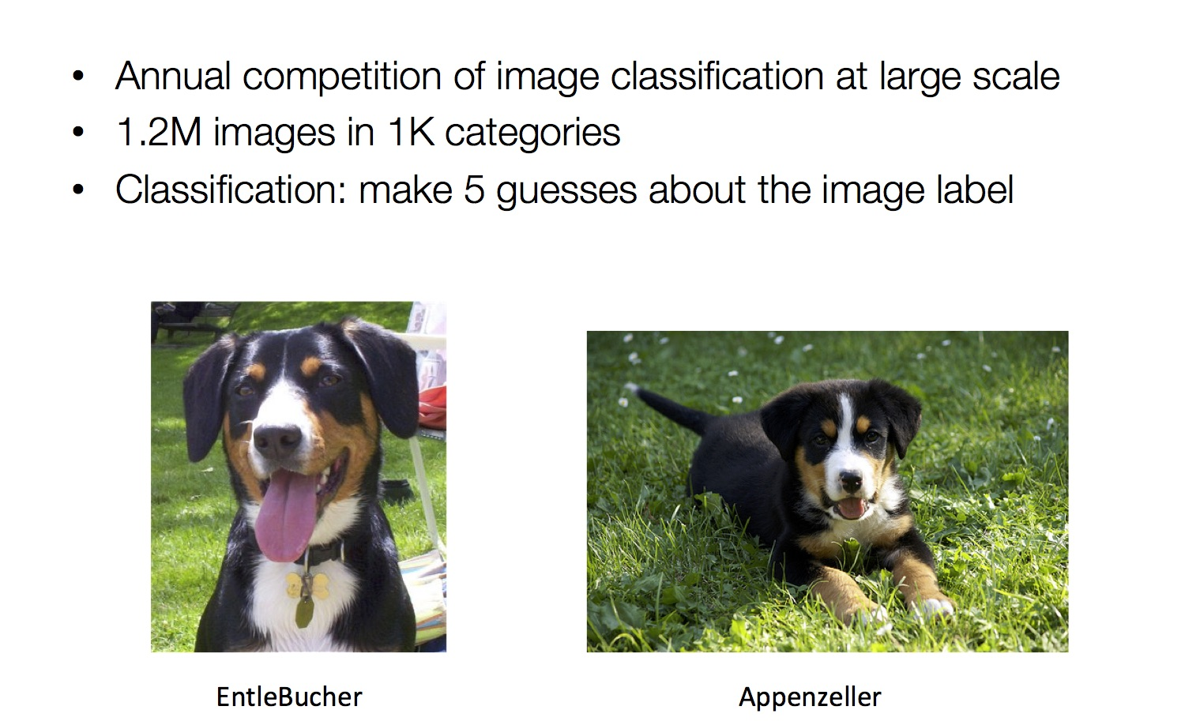
ILSVRC Image net Large Scale Vision Recognition Competition
RGB: 224 x 224 x 3 = 150,528 raw real valued features
Notes:
Top-5 error – Is target label one of your top 5 predictions ) Dog, dogtype, etc.
224x224x3 (RGB) input – 150,000 raw input features
Image net larger 15M and 22k classes

Slide 27
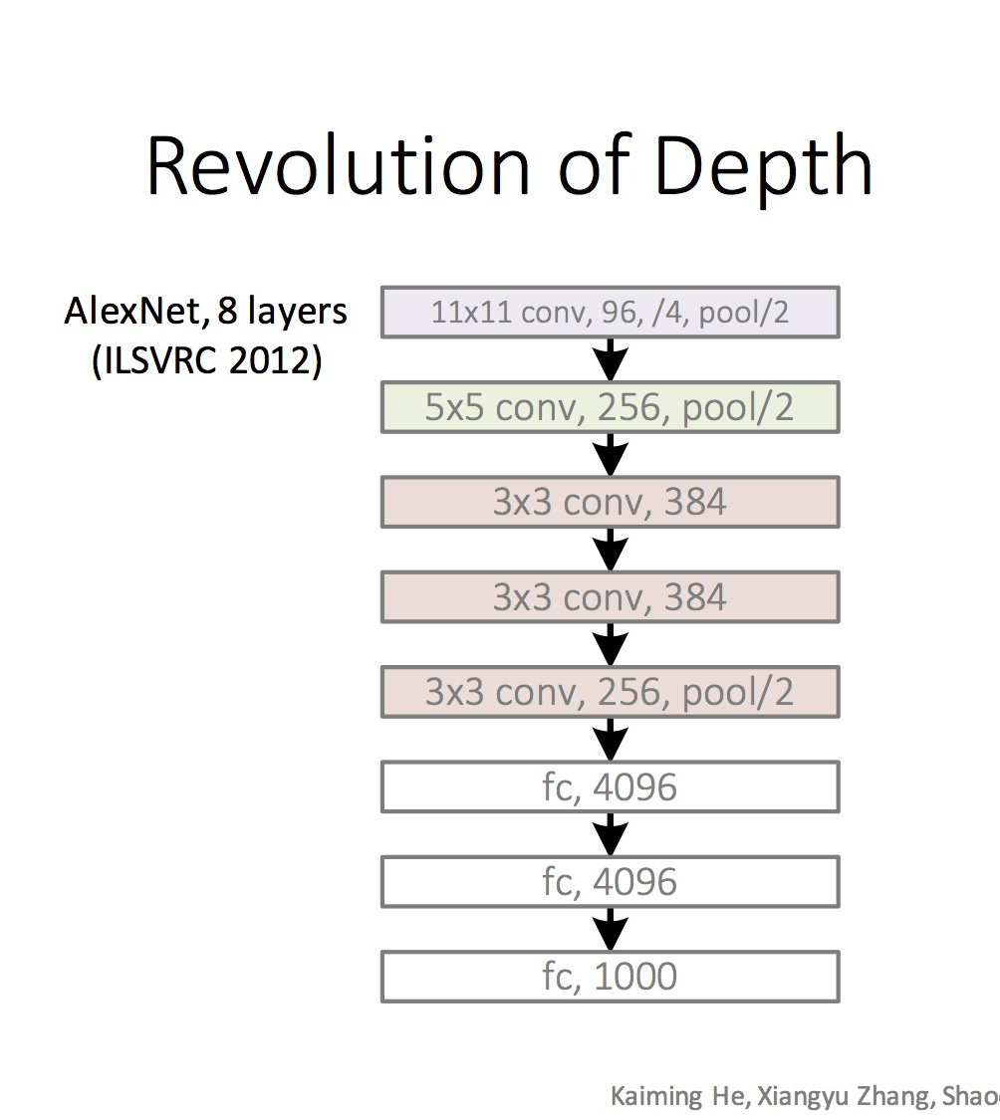
Example CNNs Structures ILSVRC winners
Note Pooling considered part of the layer
96 convolution kernels, then 256, then 384
Stride of 4 for first convolution kernel, 1 for the rest
Pooling layers with 3x3 receptive fields and stride of 2 throughout
Finishes with fully connected (fc) MLP with 2 hidden layers and 1000 output nodes for classes
Notes:
Alex Krizhevsky w/Hinton
Note Convolution and Pool often considered one convolutional layer (Layers are number of layers with convolution)
96 kernels/feature maps, then 256, etc.
/4 stride of 4 for convolution first layer, 1 for rest
/2 stride 2 overlapped pooling throughout – Alex net uses 3x3 pooling receptive field
Used local response normalization – Lateral inhibition approach with ReLUs which increase highest neurons while inhibiting local neighbors

Slide 28
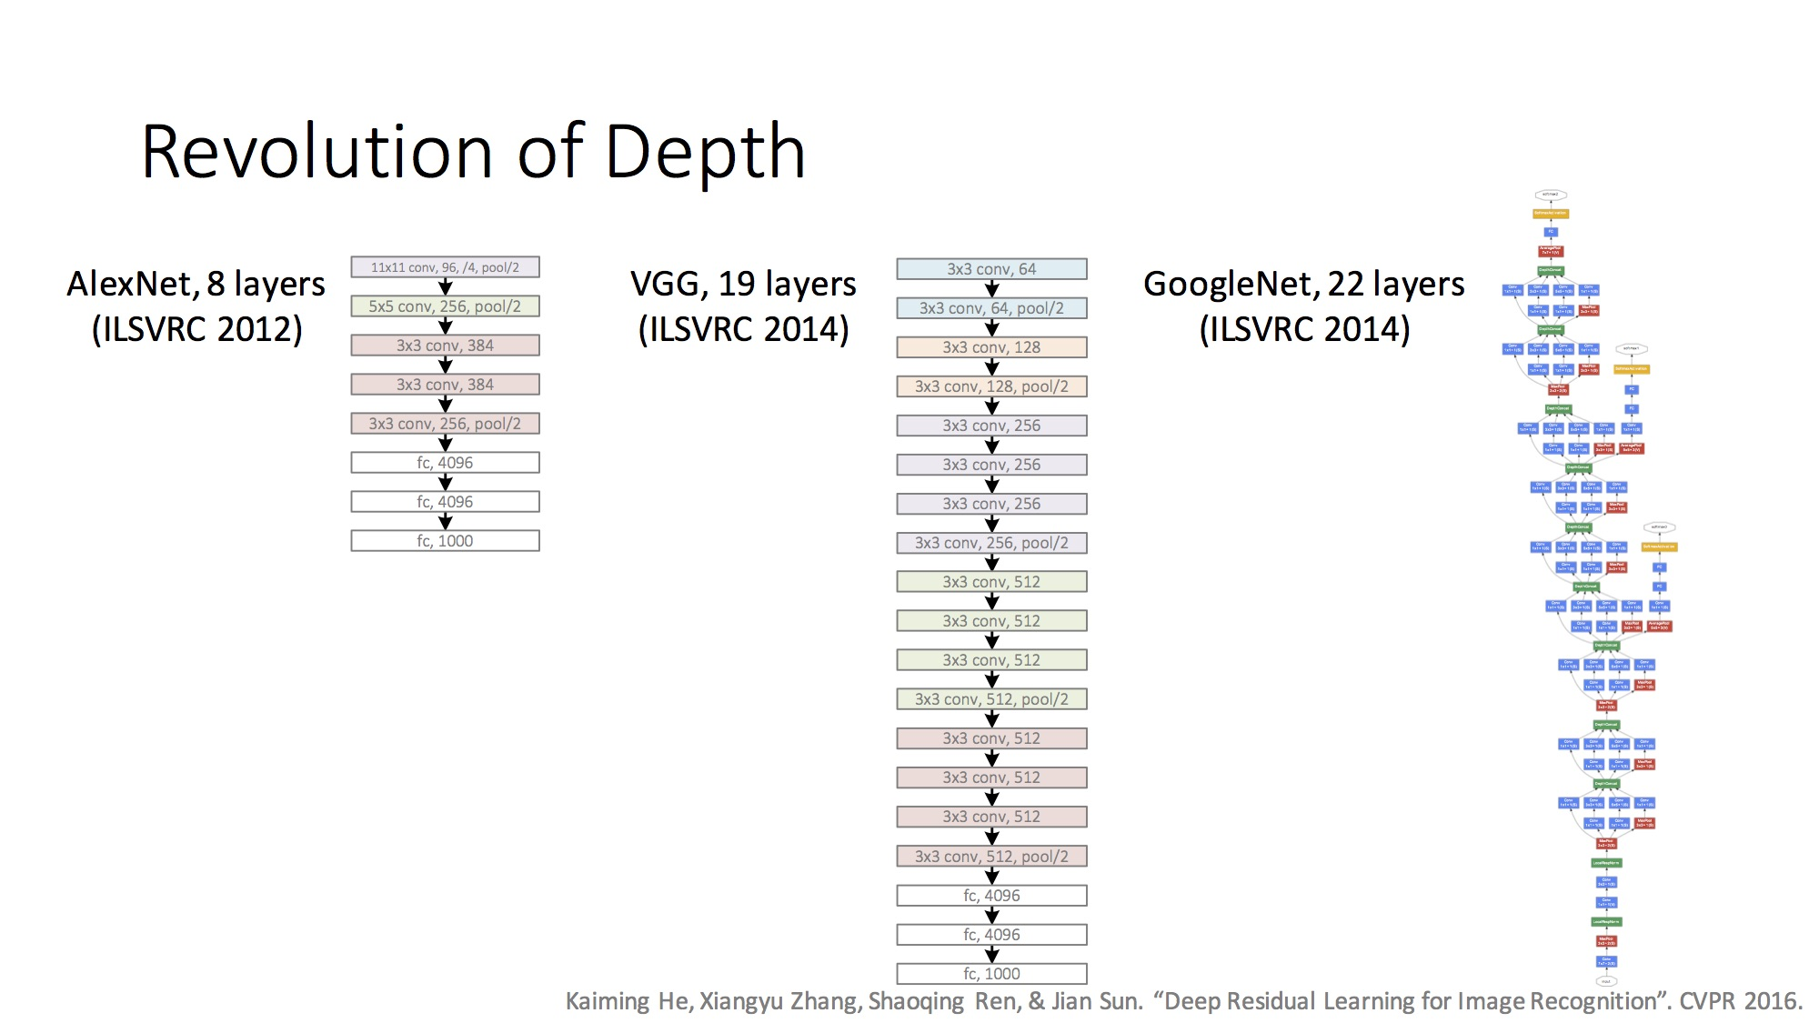
Example CNNs Structures ILSVRC winners
Notes:
VGG – Very Deep CNNs – Visual Geometry Group (VGG) Oxford, England - small filters 3x3 (smallest possible to give Up down left right) with more depth (19 layers), zero pad to maintain volume
Stride 1 for convolution, stride 2 for pooling, pooling only every 4 layers

Slide 29
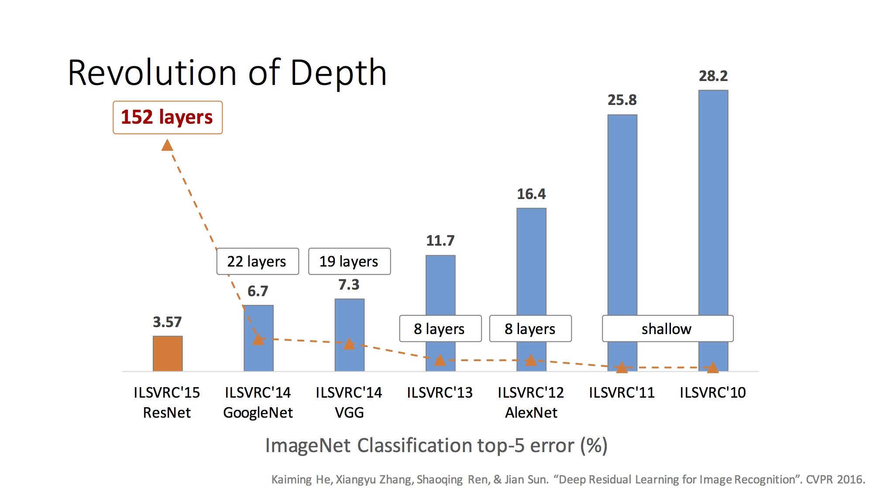
Increasing Depth
Notes:
2015 - Ensemble of Residual Networks
Reaching human levels of discrimination
2016 – down to 3.0% with ensemble, but not a new model (boring?) – No new major architectures, reaching Bayes limit, Interest waned and many main competitors had moved on

Slide 30
CNN Summary
High accuracy for image applications – Breaking all records and doing it using just using just raw pixel features!
Special purpose net – Just for images or problems with strong grid-like local spatial/temporal correlation
Once trained on one problem (e.g. vision) could use same net (often tuned) for a new similar problem – general creator of vision features
Unlike traditional nets, handles variable sized inputs
Same filters and weights, just convolve across different sized image and dynamically scale size of pooling regions (not # of nodes), to normalize
Different sized images, different length speech segments, etc.
Lots of hand crafting and CV tuning to find the right recipe of receptive fields, layer interconnections, etc.
Lots more Hyperparameters than standard nets, and even than other deep networks, since the structures of CNNs are more handcrafted
CNNs getting wider and deeper with speed-up techniques (e.g. GPU, ReLU, etc.) and lots of current research, excitement, and success
Notes:
Dynamic size – Pooling region just sums/maxes over an area with one final weight so no hard changes when we adjust pool region size
Simard 2003, Simple consistent CNN structure 5x5 with 2x2 subsampling with number of features 5 in first C-layer, 50 in next, until too small.
Don’t actually used pool layer as instead just connect every other node which samples rather than max/average.
Each layer reduces feature size by (n-3)/2. Just two layers for mnist.
They also use elastic distortions which is a type of jitter to get increased data. 99.6% - best at the time, Distortions also help a lot with standard MLP
Thus an approach with less Hyperparameter fiddling
Ciresan and Schmidhuber 2012, Multi column DNN. CNN with depth 6-10 (deeper if initial input image is bigger), and wider on fields, 1-2 hidden layers in MLP, columns are CNNs (an ensemble with different parameters, features, etc.) where their output is averaged, jitter inputs, multi-day GPU training, annealed LR (.001 dropping to .00003) 99.76% mnist

Slide 31
Unsupervised Pre-Training
Began the hype of Deep-Learning (2006)
Before CNNs were fully recognized for what they could do
Less popular at the moment, with recent supervised success, but still at the core of many new research directions including generative deep networks
Unsupervised Pre-Training uses unsupervised learning in the deep layers to transform the inputs into features that are easier to learn by a final supervised model
Unsupervised training between layers can decompose the problem into distributed sub-problems (with higher levels of abstraction) to be further decomposed at subsequent layers
Often not a lot of labeled data available while there may be lots of unlabeled data. Unsupervised Pre-Training can take advantage of unlabeled data. Can be a huge issue for some tasks.
Unsupervised and Semi-Supervised
Self-Taught Learning

Slide 32
Self Taught vs Unsupervised Learning
When using Unsupervised Learning as a pre-processor to supervised learning you are typically given examples from the same distribution as the later supervised instances will come from
Assume the distribution comes from a set containing just examples from a defined set up possible output classes, but the label is not available (e.g. images of car vs trains vs motorcycles)
In Self-Taught Learning we do not require that the later supervised instances come from the same distribution
e.g., Do self-taught learning with any images, even though later you will do supervised learning with just cars, trains and motorcycles.
These types of distributions are more readily available than ones which just have the classes of interest (i.e. not labeled as car or train or motorcycle)
However, if distributions are very different…
New tasks share concepts/features from existing data and statistical regularities in the input distribution that many tasks can benefit from
Can re-use well-trained nets as starting points for other tasks
Note similarities to supervised multi-task and transfer learning
Both unsupervised and self-taught approaches reasonable in deep learning models
Notes:
Can use same approaches with supervised nets (CNNs, etc.)

Slide 33
Greedy Layer-Wise Training
Train first layer using your data without the labels (unsupervised)
Since there are no targets at this level, labels don't help. Could also use the more abundant unlabeled data which is not part of the training set (i.e. unsupervised and/or self-taught learning).
Then freeze the first layer parameters and start training the second layer using the output of the first layer as the unsupervised input to the second layer
Repeat this for as many layers as desired
This builds the set of robust features
Use the outputs of the final layer as inputs to a supervised layer/model and train the last supervised layer(s) (leave early weights frozen)
Unfreeze all weights and fine tune the full network by training with a supervised approach, given the pre-training weight settings
Notes:
If do full supervised, we may not bet the benefits of building up the incrementally abstracted feature space
Steps 1-4 called pre-training as it gets the weights close enough so that standard training in step 5 can be effective
Do fine tuning for sure if lots of labeled data, if little labeled data, not as helpful.

Slide 34
Deep Net with Greedy Layer Wise Training
Supervised
Learning
ML Model
New Feature Space
Unsupervised
Learning
Original Inputs
Notes:
Can input both new and original spaces

Slide 35
Greedy Layer-Wise Training
Greedy layer-wise training avoids many of the problems of trying to train a deep net in a supervised fashion
Each layer gets full learning focus in its turn since it is the only current "top" layer (no unstable gradient issues, etc.)
Can take advantage of unlabeled data
When you finally tune the entire network with supervised training the network weights have already been adjusted so that you are in a good error basin and just need fine tuning. This helps with problems of
Ineffective early layer learning
Deep network local minima
We will discuss the two early landmark approaches
Deep Belief Networks
Stacked Auto-Encoders

Slide 36
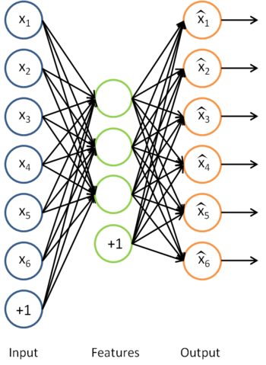
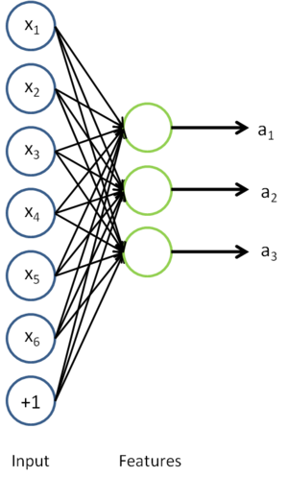
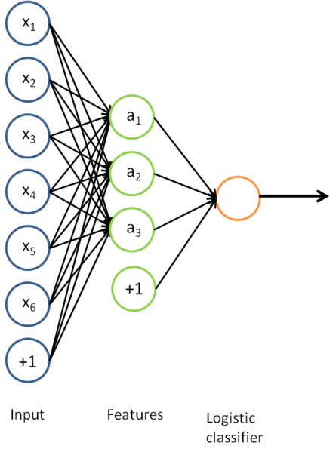
Auto-Encoders
A type of unsupervised learning which discovers generic features of the data
Learn identity function by learning important sub-features
Compression, etc. – Undercomplete |h| < |x|
For |h| ≥ |x| (Overcomplete case more common in deep nets) use regularized autoencoding: Loss function includes regularizer to make sure we don’t just pass through the data (e.g. sparsity, noise robustness, etc.)
Notes:
Though Deep Nets done first, start with auto-encoders because they are simpler
Mention Zipser auotencoder with reverse engineering, then Cottrell compression where unable to reverse engineer
If h is smaller than x then “undercomplete” autoencoding – also would use “regularized” autoencoding
Can use just new features in the new training set or concatenate both original and new

Slide 37
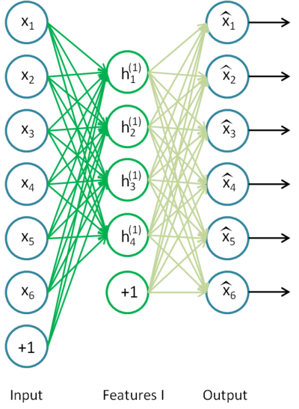
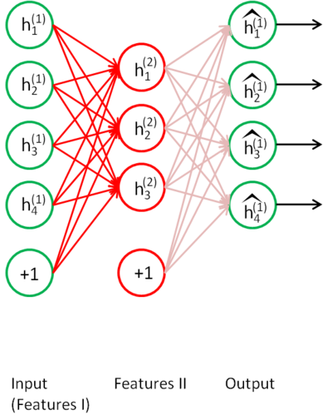
Stacked Auto-Encoders
Bengio (2007) – After Deep Belief Networks (2006)
Stack many (sparse) auto-encoders in succession and train them using greedy layer-wise training
Drop the decode output layer each time

Slide 38
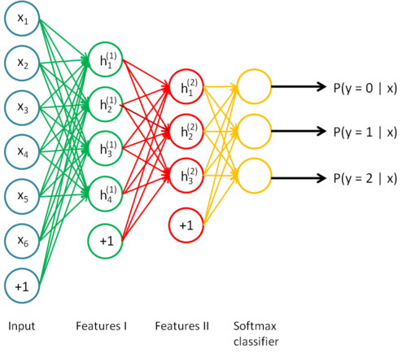
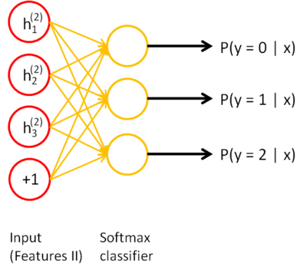
Stacked Auto-Encoders
Do supervised training (can now only used labeled examples) on the last layer using final features
Then do supervised training on the entire network to fine- tune all weights
Notes:
Shows softmax, but could use any supervised classifier
Each encoder/decoder layers could also be deep rather than one layer, empirically shown to be better vs stacking shallows to build a deep network

Slide 39
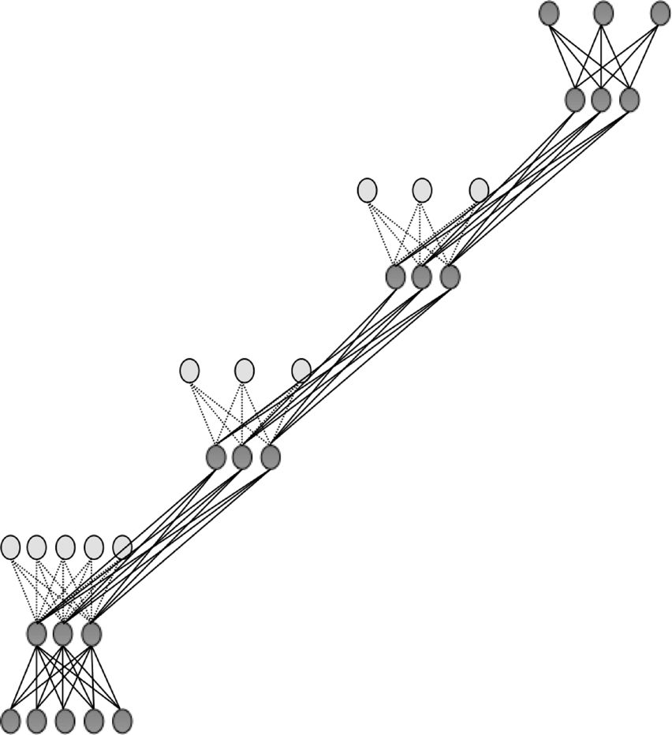

Slide 40
Sparse Encoders
Auto encoders will often do a dimensionality reduction
PCA-like or non-linear dimensionality reduction
This leads to a "dense" representation which is nice in terms of parsimony
All features typically have non-zero values for any input and the combination of values contains the compressed information
However, this distributed and entangled representation can often make it more difficult for successive layers to pick out the salient features
A sparse representation uses more features where at any given time many/most of the features will have a 0 value
Thus there is an implicit compression each time but with varying nodes
This leads to more localist variable length encodings where a particular node (or small group of nodes) with value 1 signifies the presence of a high-order feature (small set of bases)
A type of simplicity bottleneck (regularizer)
This is easier for subsequent layers to use for learning

Slide 41
Sparse Representation
For bases below, which is easier to see intuition for current pattern - if a few of these are on and the rest 0, or if all have some non-zero value?
Easier to learn if sparse
Notes:
Each square in the figure above shows the (norm bounded) input image that maximally activates one of 100 hidden units. We see that the different hidden units have learned to detect edges at different positions and orientations in the image.
This image if for a simple auto-encoder with 100 hidden units trained on 10x10 images (from UFLDL tutorial)

Slide 42
How do we implement a sparse Auto-Encoder?
Use more hidden nodes in the encoder
Use regularization techniques which encourage sparseness (e.g. a significant portion of nodes have 0 output for any given input)
Penalty in the learning function for non-zero nodes
Weight decay
etc.
De-noising Auto-Encoder
Stochastically corrupt training instance each time, but still train auto-encoder to decode the uncorrupted instance, forcing it to de-noise and learn conditional dependencies within the instance
Improved empirical results, handles missing values well
Notes:
And make sure it doesn't just learn the pass through identity
Sparsity parameter (approach in UFLDL tutorial) is target average activation for all hidden nodes across training set (e.g. .05) requires a forward pass of all data first to calculate current average activation, then a penalty term on error to push avg activation towards the sparsity parameter.

Slide 43
Stacked Auto-Encoders
Concatenation approach (i.e. using both hidden features and original features in final (or other) layers) can be better if not doing fine tuning. If fine tuning, the pure replacement approach can work well.
Always fine tune if there is a sufficient amount of labeled data
For real valued inputs, MLP training is like regression and thus could use linear output node activations, still ReLU at hidden
Stacked Auto-Encoders empirically not quite as accurate as DBNs (Deep Belief Networks)
(with De-noising auto-encoders, stacked auto-encoders competitive with DBNs)
Not generative like DBNs, though recent work with de-noising auto-encoders may allow generative capacity
Notes:
Linear decoder, And note that with linear output activations the error signal at the output layer is (t-net)*f’(net) = t-net since f’(net)=1,
But standard MLP error, etc. at hidden nodes!

Slide 44
Deep Belief Networks (DBN)
Geoff Hinton (2006) – Beginning of Deep Learning hype – outperformed kernel methods on MNIST – Also generative
Uses Greedy layer-wise training but each layer is an RBM (Restricted Boltzmann Machine)
RBM is a constrained
Boltzmann machine with
No lateral connections between
hidden (h) and visible (x) nodes
Symmetric weights
Does not use annealing/temperature, but that is all right since each RBM not seeking a global minima, but rather an incremental transformation of the feature space
Typically uses probabilistic logistic node, but other activations possible
Notes:
Remember Hinton was also the Boltzmann guy
RBM originally called “Harmonium”
Not used much these days

Slide 45
RBM Sampling and Training
Initial state typically set to a training
example x (can be real valued)
Because of RBM sampling is simple iterative back and forth process
P(h_{i} = 1|x) = sigmoid(W_{i}x + c_{i}) = 1/(1+e^{-net(hi)}) // c_{i} is hidden node bias
P(x_{i} = 1|h) = sigmoid(W'_{i}h + b_{i}) = 1/(1+e^{-net(xi)}) // b_{i} is visible node bias
Contrastive Divergence (CD-k): How much contrast (in the statistical distribution) is there in the divergence from the original training example to the relaxed version after k relaxation steps
Then update weights to decrease the divergence as in Boltzmann
Typically just do CD-1 (Good empirical results)
Since small learning rate, doing many CD-1 updates is similar to doing fewer versions of CD-k with k > 1
Note CD-1 just needs to get the gradient direction right, which it usually does, and then change weights in that direction according to the learning rate
Notes:
Since x starts as a training example, after a bit of training, it should already be close to/in an energy well
RBM allows a tractable block Gibbs sampling (all nodes in a layer sampled at once) because the nodes in a layer are all independent of one another given the opposite layer (i.e. no lateral connections). Otherwise sampling to get is much more complex (intractable)

Slide 46
Notes:
Delta wij = x1(initial x1) * h1 (initial sample) – Q(hk) (final h probablity) * xk (final x sample)
Q and P are probability distribution vectors, for hidden(h) and visible/input (x) vectors respectively
Do a small example on the board, at least one x value real and not all same weights (set it up like HW)
Why back to Q?, need a p1, q1, p2. q2 then can update
Note W update based on when they are both simultaneously on as in standard Boltzmann If h1 and x1 both 1 then weight change >= 0, else <=0, if x2 = 0, then no weight change, else change by c*Q(h2), real or sampled
Delta w works both ways for h and x. Delta w = initial product of x1 and h1 – final product of xk and Qk)
binomial is standard MLP sigmoid unit

Slide 47
RBM Update Notes and Variations
Binomial unit means the standard MLP sigmoid unit
Q and P are probability distribution vectors for hidden (h) and visible/input (x) vectors respectively
During relaxation/weight update can alternatively do updates based on the real valued probabilities (sigmoid(net)) rather than the 1/0 sampled logistic states
Always use actual/binary values from initial x -> h
Doing this makes the hidden nodes a sparser bottleneck and is a regularizer helping to avoid overfit
Could use probabilities on the h -> x and/or final x -> h
in CD-k the final update of the hidden nodes usually use the probability value to decrease the final arbitrary sampling variation (sampling noise)
Lateral restrictions of RBM allow this fast sampling
Notes:
No lateral – allows set up and back passes
Optional: Persistent MCMC for free (negative) phase – Just keep sampling from a long-term chain (ignoring the weight updates)
trade-off long term chain accuracy vs updated weights
Early sampling can be a type of de-noise which could aid sparseness

Slide 48
RBM Update Variations and Notes
Initial weights, small random, 0 mean, sd ~ .01
Don't want hidden node probabilities early on to be close to 0 or 1, else slows learning, since less early randomness/mixing? Note that this is a bit like annealing/temperature in Boltzmann
Set initial x bias values as a function of how often node is on in the training data, and h biases to 0 or negative to encourage sparsity
Better speed when using momentum (~.5)
Weight decay good for smoothing and also encouraging more mixing (hidden nodes more stochastic when they do not have large net magnitudes)
Also a reason to increase k over time in CD-k as mixing decreases as weight magnitudes increase

Slide 49
Deep Belief Network Training
Same greedy layer-wise approach
First train lowest RBM (h⁰ – h¹) using RBM update algorithm (note h⁰ is x)
Freeze weights and train subsequent RBM layers
Then connect final outputs to a supervised model and train that model
Finally, unfreeze all weights, and fine tune as an MLP using the initial weights found by DBN training
Can do execution as just the tuned MLP or as the RBM sampler with the tuned weights
During execution can iterate multiple times at the top RBM layer
Notes:
Picture above is for generative model (so ignore solid vs dotted lines at this point

Slide 50
Can use DBN as a Generative model to create sample x vectors
Initialize top layer to an arbitrary vector (commonly a training set vector)
Gibbs sample (relaxation) between the top two layers m times
If we initialize top layer with values obtained from a training example, then need less Gibbs samples
Pass the vector down through the network, sampling with the calculated probabilities at each layer
Last sample at bottom is the generated x vector (can be real valued if we use the probability vector rather than sample)
Alternatively, can start with an x at the bottom, relax to a top value, then start from that vector when generating a new x, which is the dotted lines version. More like standard Boltzmann machine processing.
Notes:
Alternatively, Can start with an x at bottom, relax to a top value, then start from that vector when generating a new x, which is the dotted lines added version

Slide 51
Middle for-loop samples from input up to current RBM layer being updated – none for 1st layer
Notes:
Initial x can be real valued
Note that nodes have two sets of biases. Only one is used at a time depending on if node is visible or hidden for that layer
While loop does RBM weight training until convergence for the kth layer
second for loop samples from x up to k-1 so that we can then do RBM update at the kth layer
Mean_field_computation just a flag on whether we sample or use the real values – Lots of wiggle room here, could do it different for different layers or even randomly, etc.
Follow through code for k=1 and k=3 so they see the flow

Slide 52
DBN Execution
After all layers have learned then the output of the last layer can be input to a supervised learning model
Note that at this point we could potentially throw away all the downward weights in the network as they will not actually be used during the normal feedforward execution process (as we did with the Stacked Auto Encoder)
Note that except for the downward bias weights b they are the same symmetric weights anyways
If we are relaxing M times in the top layer then we would still need the downward weights for that layer
Also if we are generating x values we would need all of them
The final weight tuning is usually done as an MLP with backpropagation, which only updates the feedforward weights, ignoring any downward weights
Can do execution as just the tuned MLP or as the RBM sampler with the tuned weights
Notes:
Downward weights were mostly necessary for training the feedforward weights

Slide 53
DBN Learning Notes
RBM stopping criteria still in issue. One common approach is reconstruction error which is the probability that the final x after CD-k is the initial x. (i.e. P(􏰀x|E[h|x􏰈]). The other most common approach is AIC (Annealed Importance Sampling). Both have been shown to be problematic.
Each layer updates weights so as to make training sample patterns more likely (lower energy) in the free state (and non-training sample patterns less likely).
This unsupervised approach learns broad features (in the hidden/subsequent layers of RBMs) which can aid in the process of making the types of patterns found in the training set more likely. This discovers features which can be associated across training patterns, and thus potentially helpful for other goals with the training set (classification, compression, etc.)
Note still pairwise weights in RBMs, but because we can choose the number of hidden units and layers, we can represent any arbitrary distribution

Slide 54
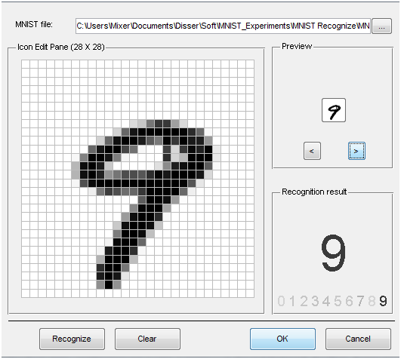
MNIST
Notes:
Go to project page
Mnist 28x28 (784) grey scale (0-255) values.
Could do some smarter preprocessing of features!
Just use straight data as our baseline.

Slide 55
DBN Project Notes
To be consistent just use 28×28 (764) data set of gray scale values (0-255)
Normalize to 0-1
Could try better preprocessing if want and helps in published accuracies, but start/stay with this
Small random initial weights
Parameters
Hinton Paper, others – do a little searching and e-mail me a reference for extra credit points
http://yann.lecun.com/exdb/mnist/ for sample approaches
Straight 200 hidden node MLP does quite good ~98%
Rough Hyperparameters - LR: ~.05-.1, Momentum ~.5
Best class DBN results: ~98.5% - which is competitive
About half students never beat MLP baseline
Can you beat the 98.5%?
Notes:
MLP results much better than that reported by LeCun and beats many of the other papers, including some of the Deep net results. BP results 1998, slower machines, higher LR, etc.??
http://yann.lecun.com/exdb/mnist/

Slide 56
Deep Learning Project Past Experience
Structure: ~3 hidden layers, ~500ish nodes/layer, more nodes/layers can be better but training is longer
Training time:
DBN: ~10 epochs with the 60K set, small LR ~.005 often good
Can go longer, does not seem to overfit with the large data set
SAE: Can saturate/overfit, ~3 epochs good, but will be a function of your de-noising approach, which is essential for sparsity, use small LR ~.005, long training – up to 50 hours, got 98.55
Larger learning rates often lead low accuracy for both DBN and SAE
Sampling vs using real probability value in DBN
Best results found when using real values vs. sampling
Some found sampling on the back-step of learning helps
When using sampling, probably requires longer training, but could actually lead to bigger improvements in the long run
Typical forward flow non-sampled during execution, but could do some sampling on the m iterations at the top layer. Some success with back-step at the top layer iteration (most don't do this at all)
We need to try/discover better variations
Notes:
Examples where nothing happening with quality learning, but once LR get low enough, suddenly they both learn real well.

Slide 57
Deep Learning Project Past Experience
Note: If we held out 50K of the dataset as unsupervised, then deep nets would more readily show noticeable improvement over BP
A final full network fine tune with BP always helps
But can take 20+ hours
Key take away – Most actual time spent training with different parameters. Thus, start early, and then you will have time to try multiple long runs to see which variations work. This does not take that much personal time, as you simply start it with some different parameters and go away for a day. If you wait until the last few days, there is no time to do these experiments.
Notes:
Final BP tune only works for the feedforward weights. Ignore the others which are not used anyways during normal forward processing (unless we iterate M times at the top layer).
We also could use the downward weights for generative.
Otherwise we just drop the downward weights after learning the forward weights which is what we really wanted (ala SAE).

Slide 58
DBN Notes
Can use lateral connections in RBM (no longer RBM) but sampling becomes more difficult (intractable, approximation such as MCMC) – ala standard Boltzmann requiring longer sampling chains.
Lateral connections can capture pairwise dependencies allowing the hidden nodes to focus on higher order issues. Can get better results.
Conditional and Temporal RBMs – allow node probabilities to be conditioned by some other inputs – context, recurrence (time series changes in input and internal state), etc.

Slide 59
Discrimination with Deep Networks
Discrimination approaches with DBNs (Deep Belief Net)
Use outputs of DBNs as inputs to supervised model (i.e. just an unsupervised preprocessor for feature extraction)
Basic approach we have been discussing
Train a DBN for each class. For each clamp the unknown x and iterate m times. The DBN that ends with the lowest normalized free energy (softmax variation) is the winner.
Train just one DBN for all classes, but with an additional visible unit for each class. For each output class:
Clamp the unknown x, relax, and then see which final state has lowest free energy – no need to normalize since all energies come from the same network.
See http://deeplearning.net/demos/
Notes:
The Demo shows generated instance first with just one iteration from the top RBN. In practice would not do bottom generation until after m iterations. (i.e. after top has settled into a lower energy state)
Should improve in the discrimination variation also after m steps, though seems to get good results sooner
Using Hinton's generating digits demo
http://www.cs.toronto.edu/~hinton/adi/index.htm

Slide 60
Other Deep Generative Models
Lots of research on generative models to create probabilistic models of training data with ability to generate new images, sentences, etc.
Deep Boltzmann machine – no lateral connections, simpler block sampling (ala RBM) as compared to the fully connected Boltzmann, all even/odd layers can simultaneously update
Generative Adversarial Networks (GANs)
Generative net produces samples x close to training samples
Discriminative net (adversary) must differentiate between samples from the generative net and the training set
Use error feedback on both to improve task of both nets, until discriminator can no longer distinguish, then can discard discriminator net – increasingly difficult for humans to distinguish
Notes:
DBM – All even and odd layers can be sample simultaneously - Not just up then down, thus more global continuous update
DBM, Often Greedy layer-wise training somewhat like DBN, Generative
DBM – Then if doing classification as typical, put an MLP at top layer for classification, then set as entire MLP for final tuning and classification
Lots of Boltzmann variations to model real values rather than probabilities over binary values
Thus GANs could be used to aid generation and/or discrimination?
Evaluating models can be a challenge, Human inspection?, Make sure not just copying training data (overfit)
Also convolutional generative models. Kind of an inverse CNN

Slide 61
Fully Supervised Deep Learning
Much recent success in doing fully supervised deep learning with extensions which diminish the effect of early learning difficulties (unstable gradient, etc.)
Patience (now that we know it may be worth it), faster computers, and use of GPUs
More efficient activation functions (e.g. ReLUs) in terms of both computation and avoiding f '(net)saturation
Also can be helpful to have 0 mean activations at each level, so sigmoid is frowned upon these days. If you want a saturating activation function, tanh is preferred.

Slide 62
Improved Initial Hyperparameter Settings
Shallow networks are less sensitive to many hyperparameter settings
More critical for deep learning in order to get more balanced learning across all layers
Smaller LRs – patience
To encourage sparsity sometimes initial biases set negative or more initial 0 weights are interspersed
Initial weights – initialize a little larger in effort to find a balance which learns well across all layers. Common is to select initial weights from a uniform distribution between
-c/root(node fan-in), c/root(node fan-in) (c = 1 Xavier, c = 2 He)
-c/root(node fan-in + fan-out), c/root(node fan-in + fan-out)
Can do Gaussian distribution with above as variances
Lots of other variations and current work

Slide 63
Speed up variations of SGD
Use mini-batch rather than single instance for better gradient estimate – Sometimes helpful if using GD variation more sensitive to bad gradient, and also for some parallel implementations.
Adaptive learning rate approaches important
Standard Momentum
Note the these approaches already do an averaging of grading also making mini-batch less critical
Nesterov Momentum – Calculate point you would go to if using normal momentum. Then, compute gradient at that point. Do normal update using that gradient and momentum.
Rprop – Resilient BP, if gradient sign inverts, decrease it’s individual LR, else increase it – common goal is faster in the flats, there are variants that backtrack a step, etc.
Adagrad – Scale LRs inversely proportional to sqrt(sum( historical values)) – LRs with smaller derivatives are decreased less
RMSprop – Adagrad but uses exponentially weighted moving average, older updates basically forgotten
Adam (Adaptive moments) –Momentum terms on both gradient and squared gradient (1st and 2nd moments) – update based on both
Notes:
Momentum Hits terminal velocity of c||gradient||/(1-mom). Thus .9 gives up to 10 times increase in velocity (LR)
Briet on this slide

Slide 64
Regularization – Dropout Common
For each instance drop a node (hidden or input) and its connections with probability p and train
Final net just has all averaged weights (actually scaled by 1-p)
As if ensembling 2^{n} different network substructures
Notes:
Other standard regularization approaches can be used and are needed, Dropout currently Very populat with current deep networks
Won’t overfit one particular network structure
Forces to regularize
*Dropconnect – randomly drop connections
Shakeout Instead of randomly discarding units as Dropout does at the training stage, this method randomly chooses to enhance or inverse the contributions of each unit to the next layer.
Others – Dropin, Standout, etc.

Slide 65
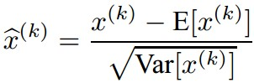
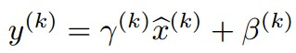
Batch Normalization (2015)
Rather than just guess initial parameters to maintain learning balance, why not renormalize activations at each layer to maintain balance
Since we like 0-mean and unit variance inputs (standard 1st layer normalization), we can just re-normalize the activation/net values at each input dimension k at each layer
Want mean and variance of that activation for the entire data set. Approximate the empirical mean and variance over a mini-batch of instances and then normalize the activation
Then scale and shift the normalized activation with 2 learnable weights per input, γ and β, to attain the final batch normalization for that activation
Notes:
Added after fully connected layers and convolutional layers in CNNs
Inputs whitened – transformed of have 0 means and unit variances, and decorrelated (ala PCA) – BN whitens at each layer
BN usually done on the net value before passing through a non-linearity.
Scale and shift step allows net to recover the initial identity function if necessary

Slide 66
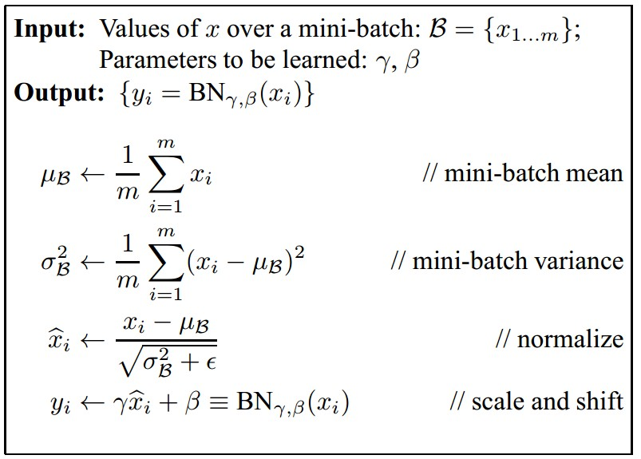
Batch Normalization
[Ioffe and Szegedy, 2015]
Note: at test time BatchNorm layer functions differently:
The mean/std are not computed based on the batch. Instead, a single fixed empirical mean of activations during training is used.
(e.g. can be estimated during training with running averages)
Allows larger LR, improves gradient flow and reduces dependence on initialization
Notes:
Drop superscript k for simplicity and looks at one activation example

Slide 67
Deep Residual Learning
Residual Nets – 100s of layers – 2015 ILSVRC winner
A CNN
Uses Batch Normalization extensively
Learns the residual mapping with respect to the identity
Simple concept which tends to make the function to be learned simpler across depth
Notes:
DRL – Learn residual F(x) every two layers as you advance through the net – difference between current input x and the goal H(x) to get to.

Slide 68
Deep Residual Learning

Slide 69
Deep Residual Learning
Notes:
H(X) is whatever is left over (residual) from the sum of the current network output and the intput x (from a few time steps back)

Slide 70
Deep Residual Learning

Slide 71
LSTM – Long Short Term Memory
LSTM unit just plugs into where a hidden node would have been – Recurrent/Deep Nets
LSTM unit has lots more parameters but still trained with standard BP/SGD learning
Forget gates, etc. don’t know that is their job, but the capacity is there during training to learn that job
Capacity plus training finds a way to solve the problem, capacity that wasn’t really there with simple network nodes
Vanishing/exploding gradient avoidance –
Cell value has a self-feedback loop and can maintain its value indefinitely. Has derivate 1 with no vanishing gradient.
Cell feedback weight was a constant 1 in original. In the modern the cell value is multiplied by a forget gate output, which decides when and how much to forget, giving much more power. Since sigmoid and can’t exceed 1, there can be no exploding gradient. Doesn’t know that is its job. It just learns it in trying to minimize loss.
Use multiple layers of LSTM units in place of normal nodes
Notes:
Could combine G and I weights, but more power this way
In the recurrency of the LSTM the activation function is the identity function with a derivative of 1.0. So, the backpropagated gradient neither vanishes or explodes when passing through, but remains constant.
The effective weight of the recurrency is equal to the forget gate activation. So, if the forget gate is on (activation close to 1.0), then the gradient does not vanish. Since the forget gate activation is never>1.0>1.0, the gradient can't explode either.
Use Maliya slides to show gradients. Need delta c to calculate c-1, since all weight deltas are just products with c, then c keeps control of vanishing/exploding gradients for most part

Slide 72
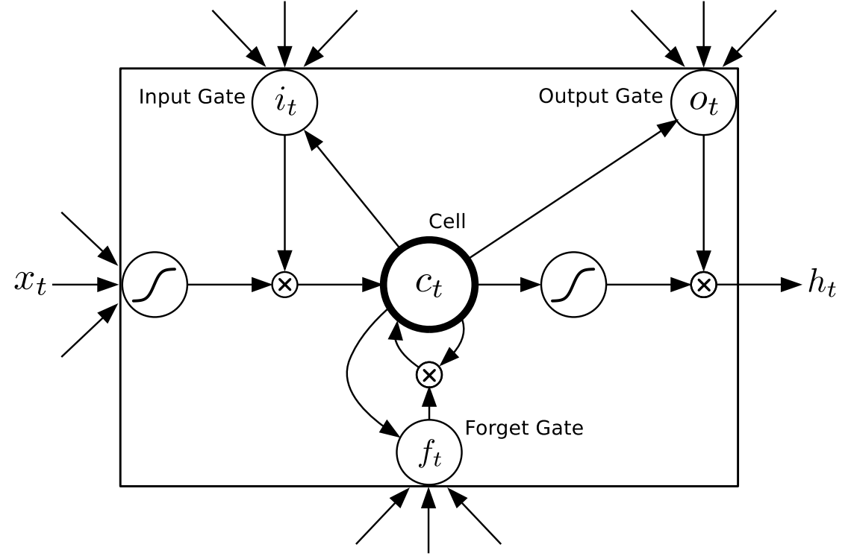
Basic Cell value has a self-feedback loop Does not forget until told (stable gradient)
Notes:
All 3 gates receive input xt (only shown on left most sigmoid) and previous state ct

Slide 75
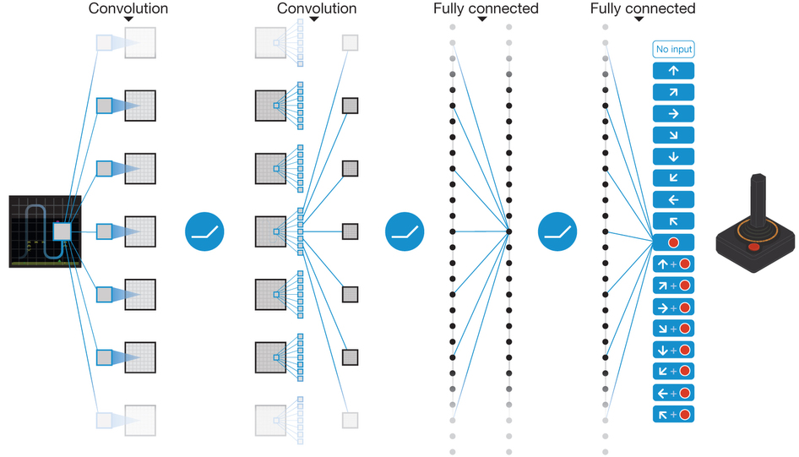
Deep Reinforcement Learning: Deep Q Network – 49 Classic Atari Games
Notes:
Overall, competitive with professional human Better than human on half. Only pixels and score. Same net, Hyperparameters, no tuning, etc.
Error – difference between current predicted Q by deep network and the actual discounted reward based on current samples and current net. Input state is made of the M=4 previous frames in order to give temporal context. One output for each action rather than needing to run net |A| times to get each Q(s,a) value.

Slide 76
Conclusion
Much recent excitement, still much to be discovered
Impressive results
More work needed to understand how and why deep learning works so well – How deep should we go?
Potential for significant improvements
Works well in structured/Markovian spaces - CNNs, etc.
Important research question: To what extent can we use Deep Learning in arbitrary feature spaces?
Recent deep learning with supervised learning and extended BP approaches show huge potential in this area

